Slide 1
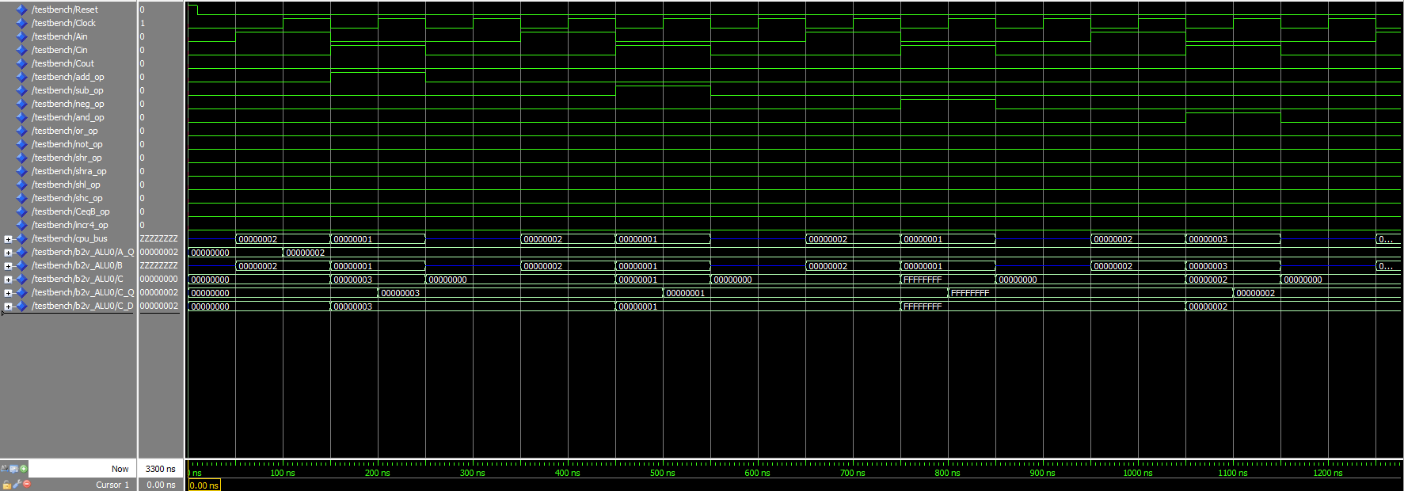
C = A + B = 2 + 1 = 3
C = A - B = 2 - 1 = 1
C = -B = -1
C = A AND B = 2 AND 3 = 2
Reset=0 and everything is zeroed out (C was defined to be 0 if no operation instruction is loaded)

Slide 2
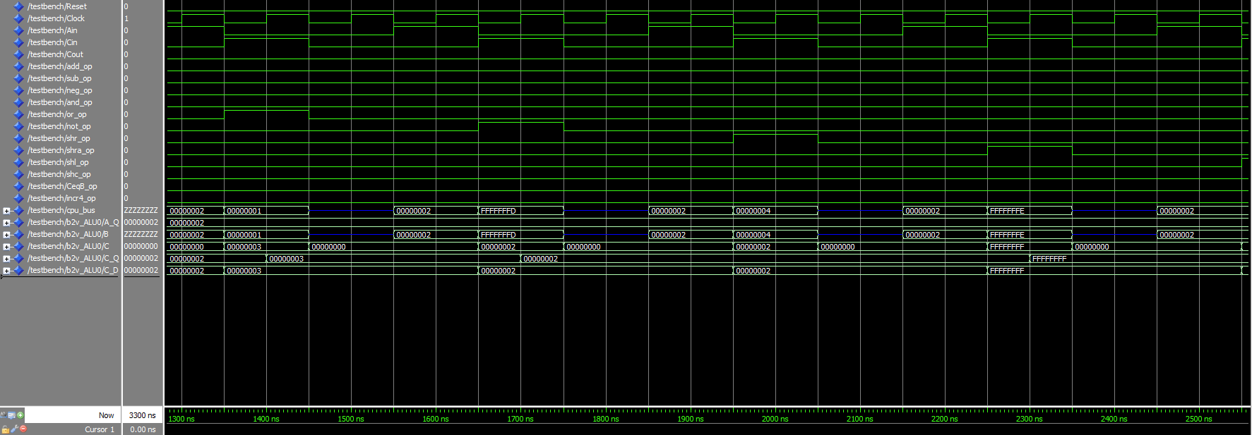
C = A OR B = 2 OR 1 = 3
C = SHR B
= SHR 4
= 2
C = SHRA B
= SHR -2
= -1
C = NOT B
= NOT 11111111111111111111111111111101
= …010
= 2

Slide 3
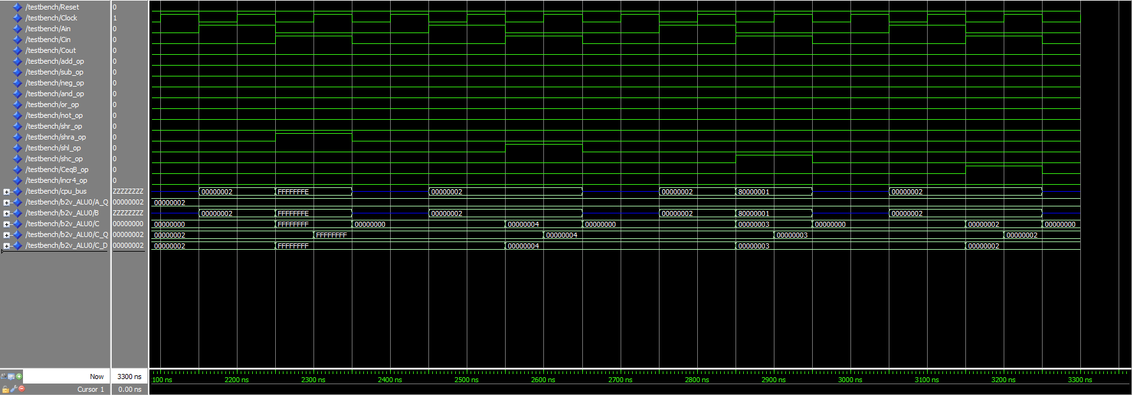
C = SHL B
= SHL 2
= 4
C = B = 2
C = SHC B
= SHC 10000000000000000000000000000001
= …011
= 3

Slide 4
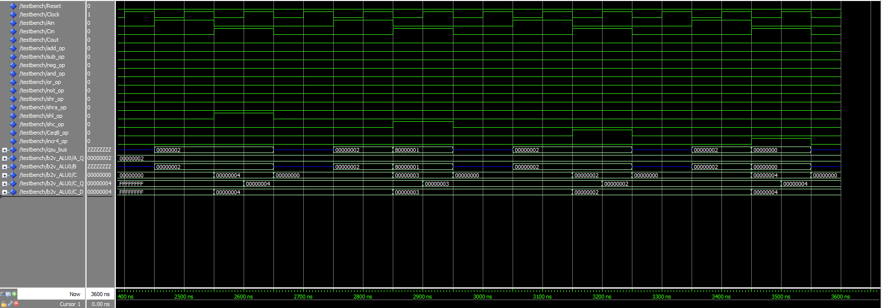
C = B + 4 = 0 + 4 = 4

